Slide 1
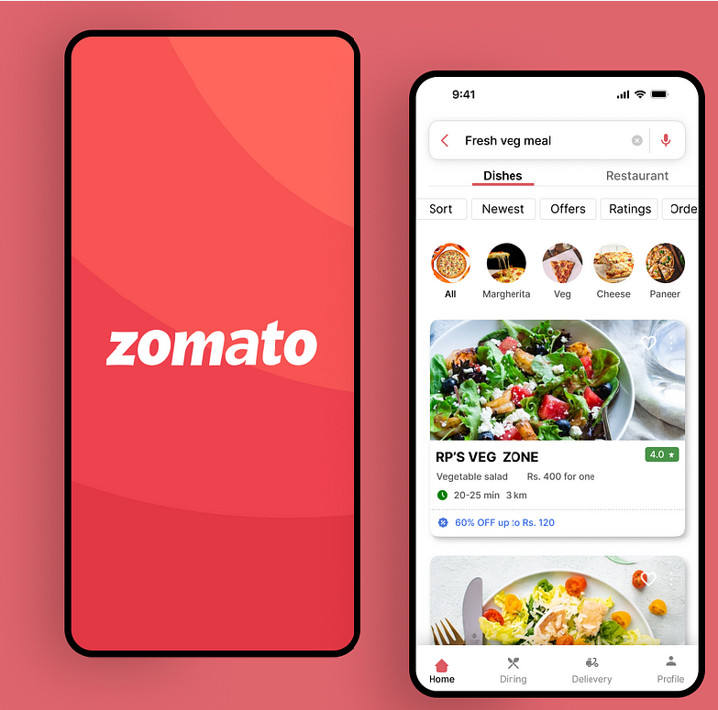
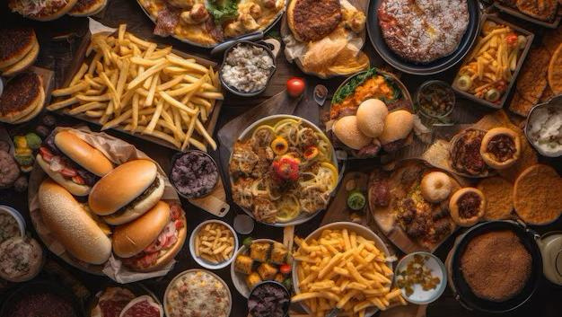







Case Study
Increasing the number of customer text reviews in the food delivery vertical
Milestone -2
Do you write review of your food ?

Slide 2










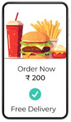
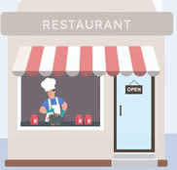


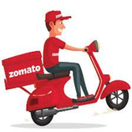


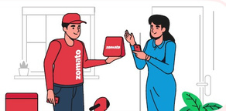


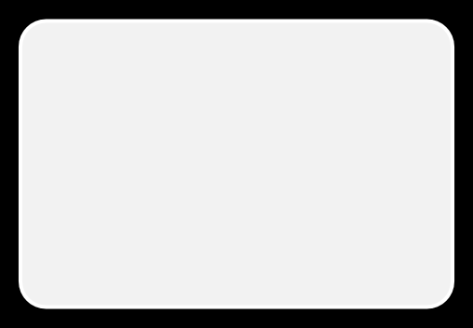
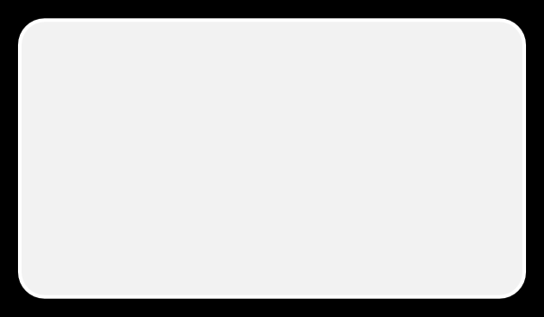
































FOOD DELIVERY SPACE -INDIA
Actors
Source –Zomato Annual Report –FY 23
Average Monthly Counts
Delivers Order to Customer
Order Placed
4
Places Order
5
1
2
3
Assign Delivery
Customers
Delivery Platforms
Restaurants
Delivery Partners
Vision
Better food for more people
17 MN
DUOPOLY
326 K
210 K
YOY Growth : 17%
YOY Growth : 16%
YOY Growth : 14%
Market Landscape
Growth Drivers
Regulations
• • • •
$4500 Mn USD Revenue by 2030
• •
•
•
• •
Enhanced User Engagement
Gamification Strategies
Favorable Demographics
Technology Integration
Rising Travel and Tourism
Impact Visibility
Delivery Platforms •FSSAI Standards •GST Registration
Restaurants
•FSSAI License
•Shop & Establishment Act License
•Health/Trade License
CAGR of 21.7%: 2023-2030
Zomato Turned Profitable in 2024
Swiggy is also gaining the market
Delivery Partners
Driving License
Vehicle Registration
Resource Registration
Source –Inc24 and Statista –Dec 23
Competition

Slide 3






















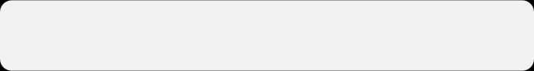







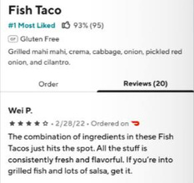
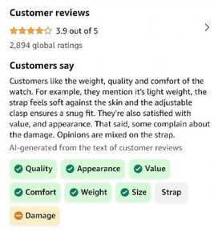










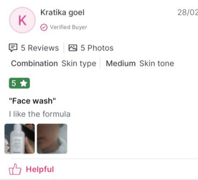
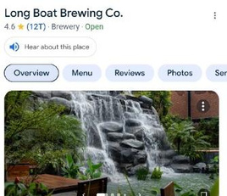






REVIEWS AND RATINGS FEATURES
Food Delivery
E-commerce
Discovery
Competitor Research
Common Features such as Star Rating and Adding Pictures are not added to this list
Before Ordering
Individual Food Items Reviews
Reviews Concluded using AI
Count of buyers who rated Top hierarchy rating and Items rating Read Reviews Individual Item Reviews Reviews consolidated using AI Listen the details and Reviews Best rated tag and filtering Reviews categorized User demographics/preferences
Most helpful and most critical on top
After Delivery
Notification nudge Rate on the homepage post itself Adding reviews based on tags Option to recommend to your contacts Quiz based reviews Rate from order history page in 1 click
NA
Skin Type and Tone with Reviews
Listen the Reviews and Details
NA
After Reviewing
Reward points Increasing reviewer rankings Early access to new features Directing to rate other bought products Positive messaging to encourage reviews

Slide 4
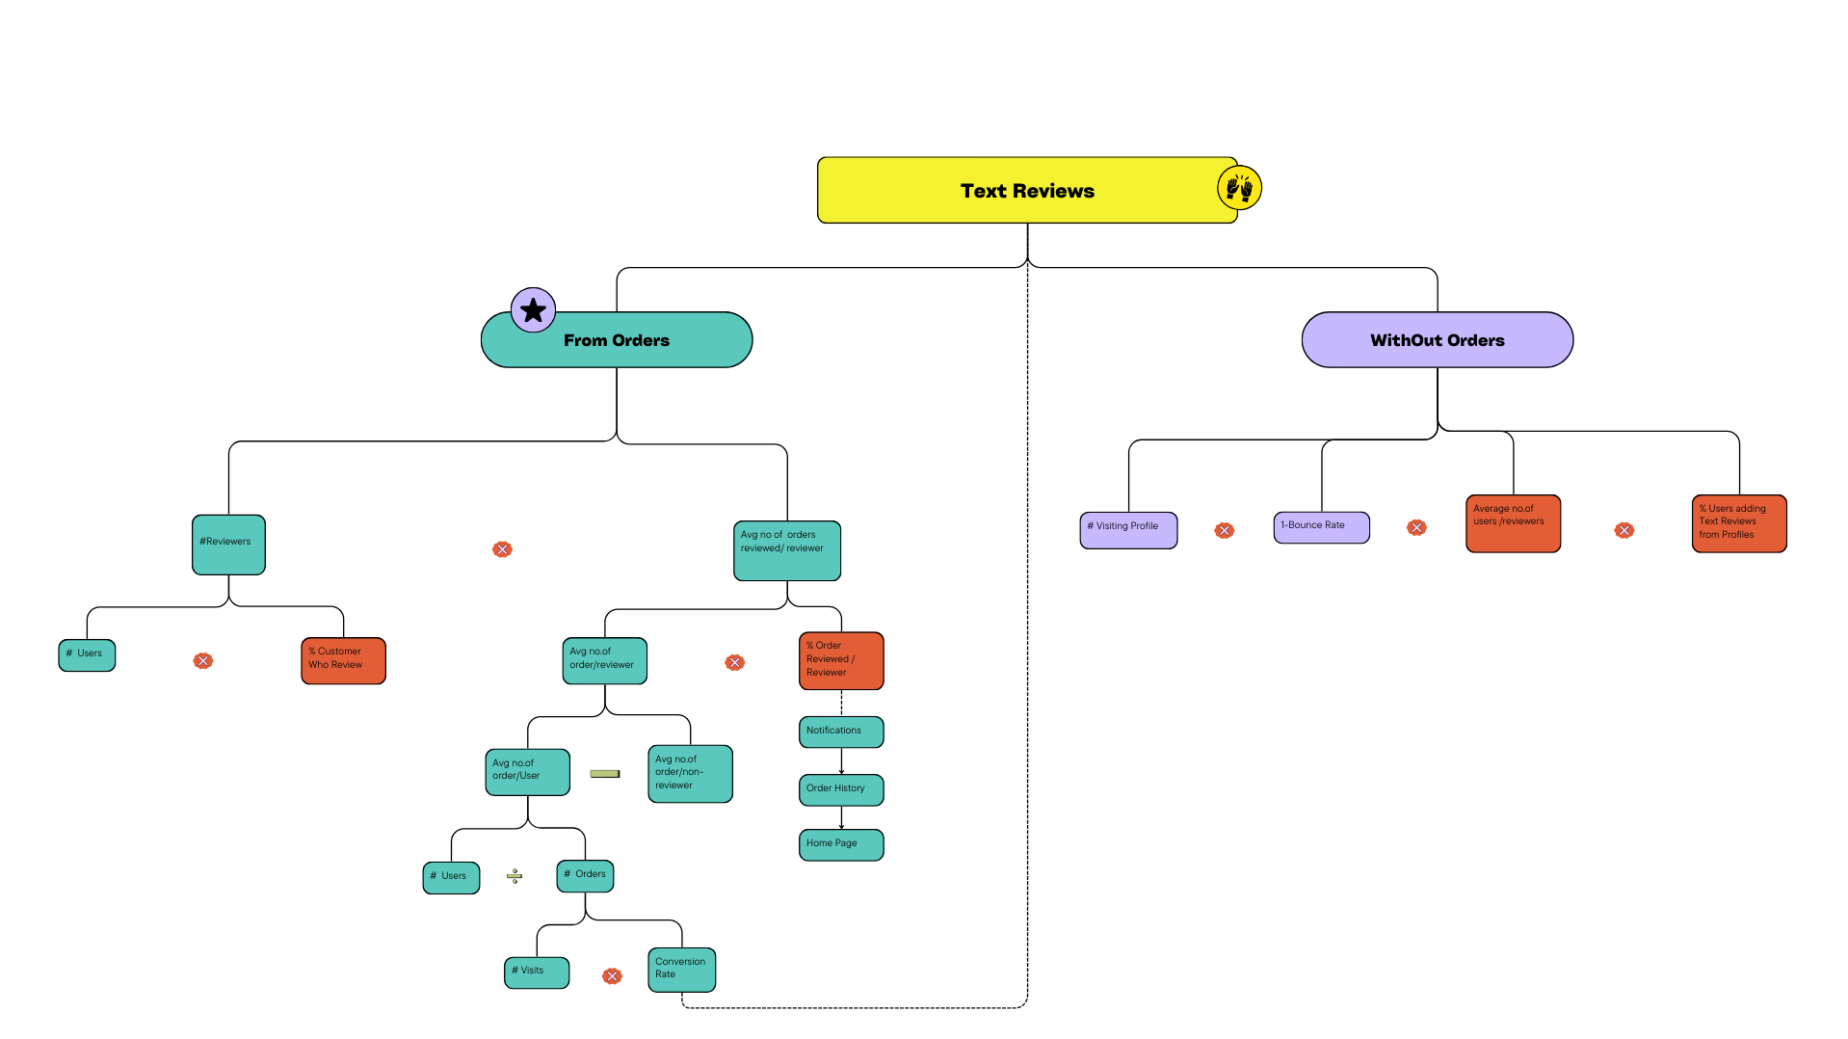







WHY REVIEWS MATTER FOR ZOMATO?
WHAT PRODUCT OUTCOMES TO BE FOCUSED ON?
Zomato aims to achieve its mission by “Building a sustainable ecosystem by improving food safety and quality with enhanced customer experience”
As per Zomato Annual Reports
Customer generated ratings and reviews ensure restaurants that offer good quality food generate more business on the platform
HOW DOES REVIEWS HELP?
• • • •
Informed choices (quality, value) Discover hidden gems Avoid bad experiences Community & trust
Trust and Credibility
Customers
•
•
•
•
Valuable customer feedback
Build reputation & attract customers
Identify strengths & weaknesses
Direct communication
Increased conversion rate -> Increased Revenue
Lesser Return Orders-> Cost Reduction
Empowered Restaurant Partners
Financial Sustainability and Profitability
Customer Retension
Restaurants
•
•
•
•
•
Target Product Outcomes
Business

Slide 5

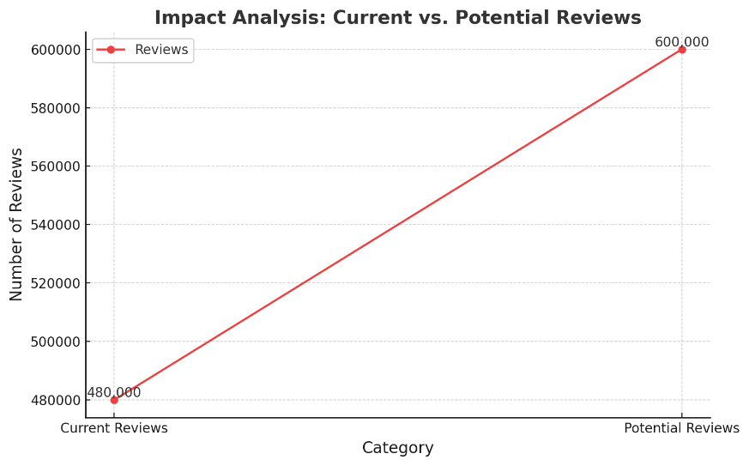




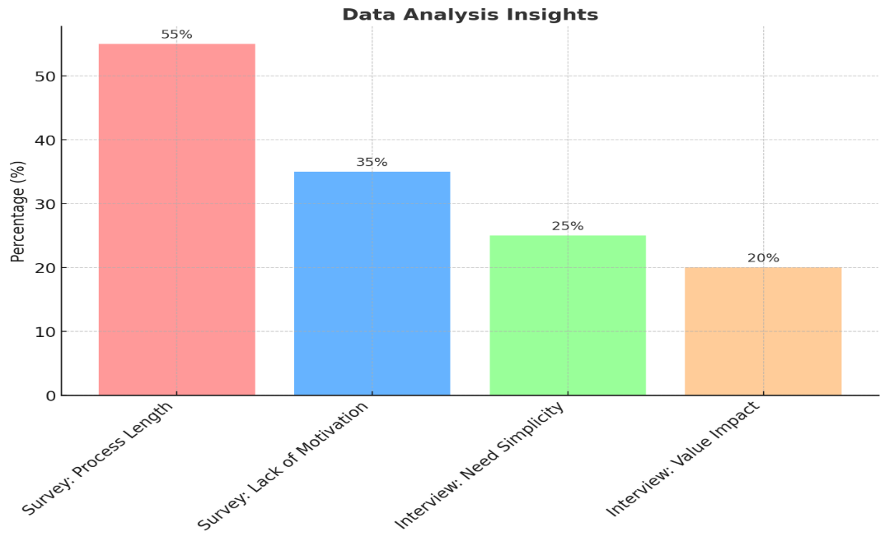

USER SEGMENTATION
IMPACT ANALYSIS
IMPACT ANALYSIS
Current Reviewers –4.8 Mn Potential Reviewers –6 Mn
As per Zomato Annual Reports 2024
MAU = 17 Mn Monthly Orders ~105 Mn = ~ 5 Order/User
More than 40% users are
ordering 5 orders per month
Infrequent
Users
Regular
Reviewers
Splitting users based on Order Frequency
Reviewers by 25%
Assumptions User’s Average Order/Month
Regular Users < 15%
Non-Reviewers < 60%
Infrequent Users < 25%
No. of Reviewers * Avg Order/User *% of order reviewed per reviewer
Regular Non-Reviewers
WHY ARE THEY NOT REVIEWING
Target User Segment --Users with High Frequency of orders
105 Mn Users Why Choose Them?
With more orders, even if they review a lesser percentage of orders, their overall impact
Is higher due to sheer volume of reviews they can potentially contribute
Regular orders expose them to varied experiences, enriching their insights
High-frequency users understand the platform deeply and have loyalty towards Zomato already
Higher Impact Through Volume
Better Insights
Deeper Understanding of the Platform

Slide 6





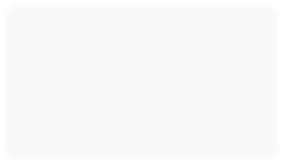

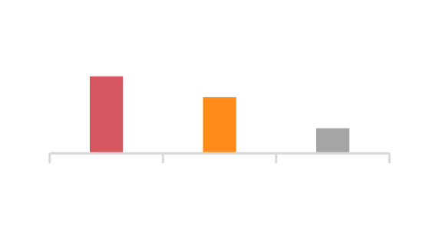

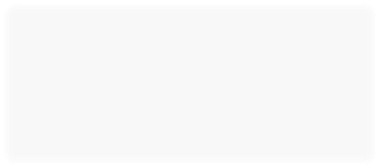



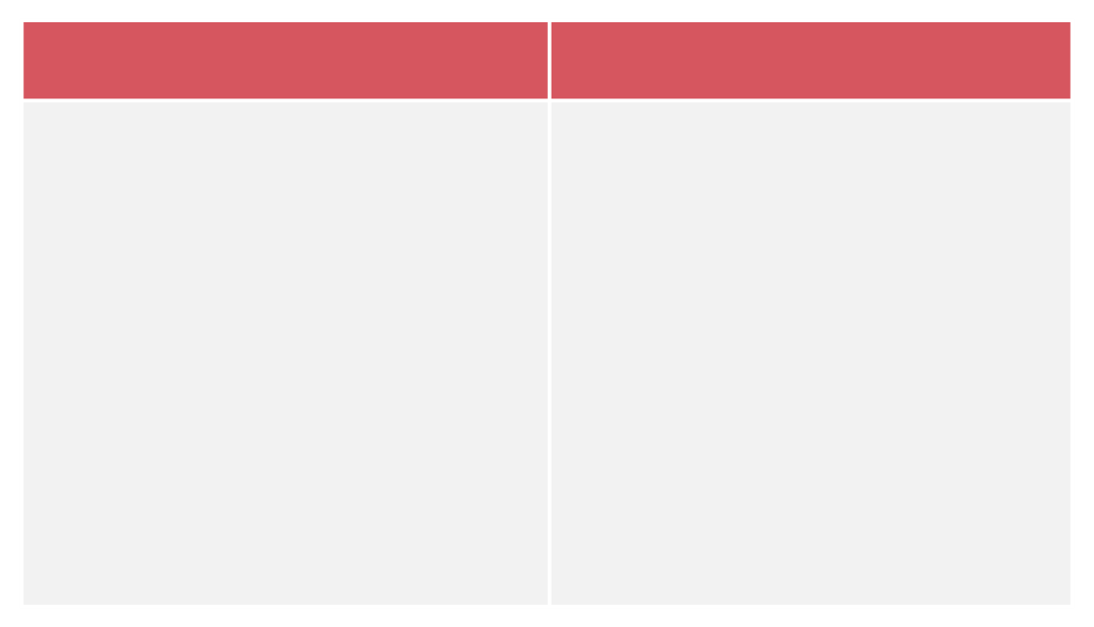











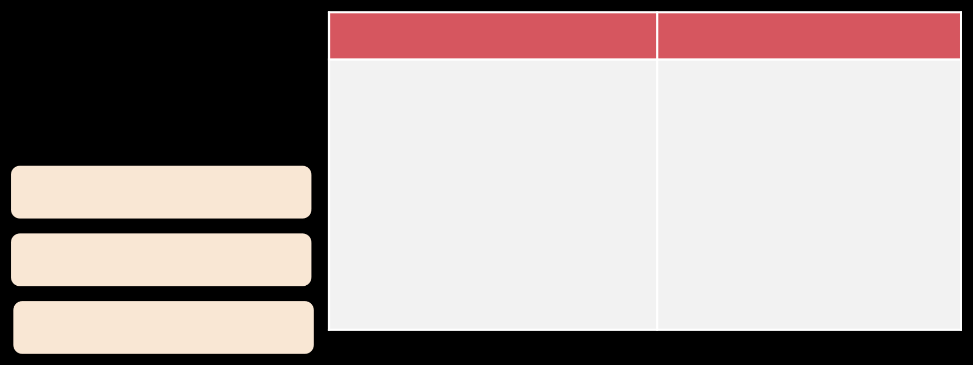
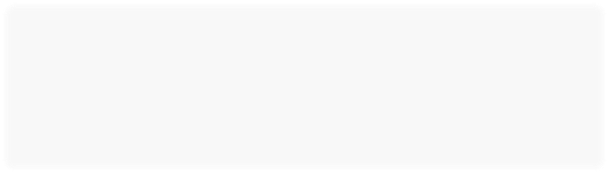



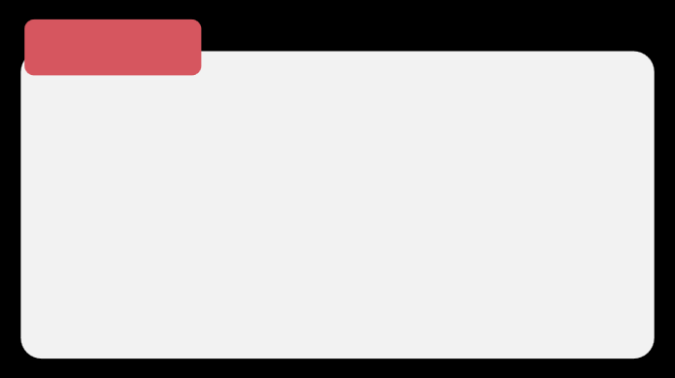
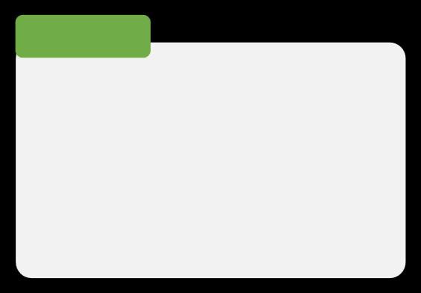



Almost everyday
USER RESEARCH –SURVEY 50 PEOPLE AND 5 INTERVIEWS
TARGET SEGMENT -USER PERSONA
Who are they?
Where do they order food from?
Survey Link
Priyanka | 32 | Java Developer | Hyderabad
She orders food every weekend as she takes break from cooking and want to try new dishes
28%
55%
80% are Millennials and GenZ
15
30%
Both
38%
11
15%
72% are from Tier 1 Cities and split between urban and sub-urban dwellers
5
Zomato Swiggy
Both
Pain Points
Needs
34%
Lives with Family
•Unable to explore new
•Seeks to discover good
40% Female
60% Male
Paid Memberships
Preferred Apps
Likes to travel
places due to time
and responsibilities
trusted reviews to
explore hidden gems
How many times do they order food in a month?
Target Segment = > 5 Orders/ Month
•Time consuming and
•Simplified and engaging
review writing process
1-2 times
3-5 times
6+ times
Wants to explore food
boring process to write
reviews
20% | 50% | 30%
10%
17%
•Not able to trust the
1 - 2
3 - 4
5 - 7
Orders something every weekend
Likes spicy traditional food
reviews before ordering
food
What does the Target Segment feel about text?
55%
%Percentage
60%
33%
25%
17%
Srinivasulu | 62 | Rt. Govt Employee| Guntur
He orders food online almost everyday as he want to explore good authenticated restaurant in the city
Say star ratings are enough
They Read ratings sometime
11%
14%
Not
1
2
3
4
5
Very
Important
Not Important
Important
Pain Points
Needs
Recently moved to Hyderabad
•Not sure how and what to write
•Honest and reflective
53%
Never writes a review
•57%people say they might consider writing a review if they find value
47%
Sometimes writes a
reviews with similar taste
review
•Hesitant to write reviews
Why?
Why?
Loves Indian Cuisine
as he feels his taste might be different
•Motivation in some
•
Do not see any value to invest time
•26%people review write
•Horrible food
•Super Awesome food
•Delivery Guy Reminder
•Want others to have a
form from the app to write reviews
•Not sure what and where to write
•Finds it boring to write
•Feel it might not be relevant to
reviews on other platforms
Likes deserts
•Concerned that his
Both categories try to rate
reviews might negatively
impact restaurants
others due to difference of taste
the delivery guys
better experience
Likes modern flavors

Slide 7





UNDERSTANDING THE PROBLEM
What is the true problem?
How do we know it is a real problem?
Zomato users do not see value in writing reviews for their orders even after ordering often. They feel it's not worth their time. As a result, there is a shortage of high-quality reviews for users seeking guidance and a lack of comprehensive feedback for restaurants.
We can be sure this is a real problem as based on our survey we found that 60% of people never write reviews on Zomato. Additionally, data from the Zomato blog shows that only 1.5% of orders have text reviews, indicating that this is a very small number, and it needs to be addressed.
Who are the customers facing this problem?
Why should we solve this problem now?
The customers facing this problem are those who order food from Zomato more frequently than the average user, which is typically more than three orders per month. These customers struggle because they cannot find quality or relatable reviews and face difficulties in choosing restaurants. Additionally, due to this a major portion of the consumer base is also finding it difficult to consume reviews or find it relevant enough to make order decisions via them.
We should solve this problem now because Zomato has recently become profitable and would be planning to expand its platform to more users and restaurants. If current users continue ordering without reviewing, new users may find it more challenging to find value from the platform. This could also make it difficult for new restaurants to attract enough users. Addressing the review issue
now will help maintain and grow Zomato's user base and revenue, as the conversion of users also depends on reviews. This will ensure the platform remains valuable for both users and restaurants
What is the value generated by solving this problem
They can make informed choices and be more assured before ordering They can explore from a wider range of restaurants due to better trust from other users They can avoid bad experiences and avoid the hassle to return and complain
They can feel a sense of community on the platform-- For the target customers
• • •
• • • •
The conversion rate depends on reviews, among other factors, and revenue is directly related to conversions. Reviews quantity can potentially increase by 41% Costs can be reduced as users will be more informed about their choices, potentially leading to fewer returns or complaints Zomato can provide comprehensive feedback to restaurants, helping them improve their offerings and services– For the Business

